Slide 1




Erasmus+ CBHE Project
International Students Adaptation and Integration/ INTERADIS
619451-EPP-1-2020-1-NL-EPPKA2-CBHE-JP
Monitoring
Online
01.10.2021

Slide 2


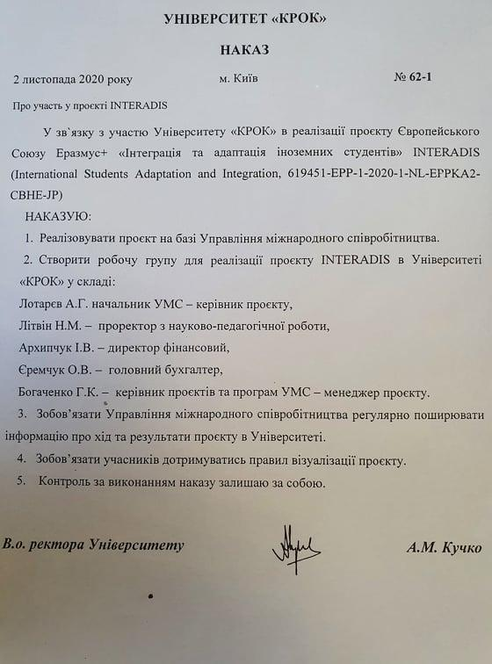
Project Team
Andrii Lotariev, Head of International Office and other staff of International Office;
Nataliia Litvin, Vice-Rector for Scientific issues;
Iryna Arkhypchuk, Chief Finance Officer;
Oksana Yeremchuk, Chief Accountant;
Galina Bohachenko, Projects and Programs Manager of IO;
Anna Drobyna, Projects and Programs Manager of IO;
Maryna Yevchenko, Administration Manager of IO;
Yuliia Khriienko, Projects and Programs Manager of IO;
Anastasiia Shepelia, Project Managers of IO;
Oleksandra Horbachenko, Administration Manager of IO.

Slide 3
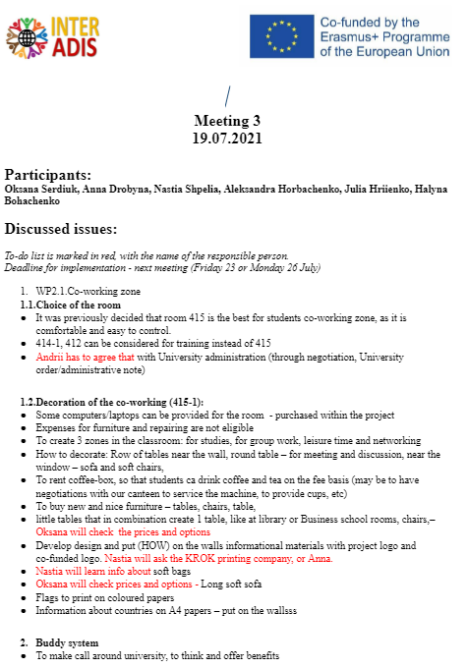
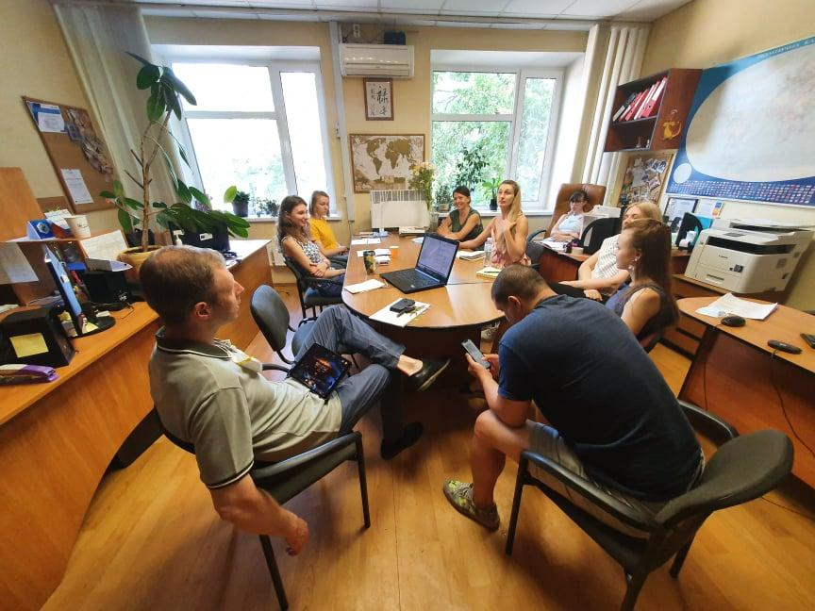
Meetings of the Project Team
Protocol of the meeting is created
List of tasks and responsibilities

Slide 4
WP 2.1. Creative co-working zone organized
(abstract from the Protocol)
WP2.1.Co-working zone
  Choice of the room
It was previously decided that room 415 is the best for students co-working zone, as it is comfortable and easy to control.
It is agreed with University administration, the Order is under preparation
Decoration of the co-working (415):
Computers/laptops will be purchased within the project
To create 3 zones in the classroom: for studies, for group work, leisure time and networking
How to decorate: Row of tables near the wall, round table – for meeting and discussion, near the window – sofa and soft chairs,
To rent coffee-box, so that students can drink coffee and tea on the fee basis (may be to have negotiations with our canteen to service the machine, to provide cups, etc)
To buy new and nice furniture – tables, chairs, table for University finances
Develop design and put (HOW) on the walls informational materials with project logo and co-funded logo.
Flags to print on coloured papers
Information about countries on A4 papers – put on the walls

Slide 5
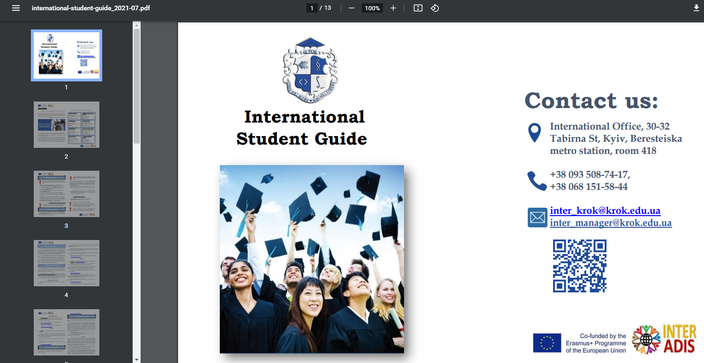
WP 2.2. Administrative procedures modernized
International Student Guide
ISG is prepared for newcomers, presented to students at the Welcome Day

Slide 6

INFORMATION IN THE GUIDE
Contact information
Opportunities at KROK
Academic and migration rules
KROK facilities
How educational process will go on
Tips to stay in Kyiv
What e-learning means krok uses for studies
Do's and dont’s
Information on DD, exchange programs
Ukraine, Places to visit

Slide 7

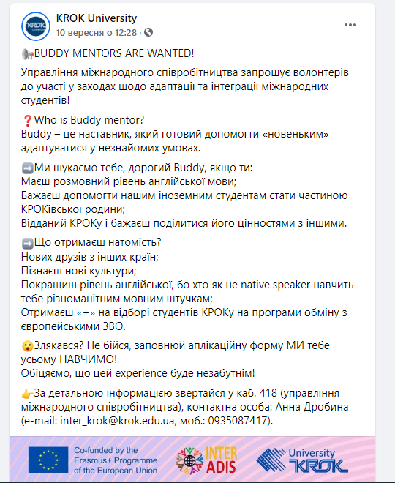
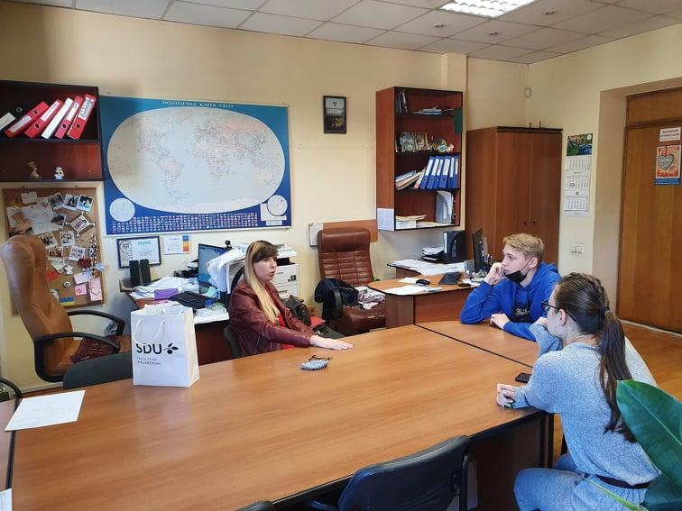
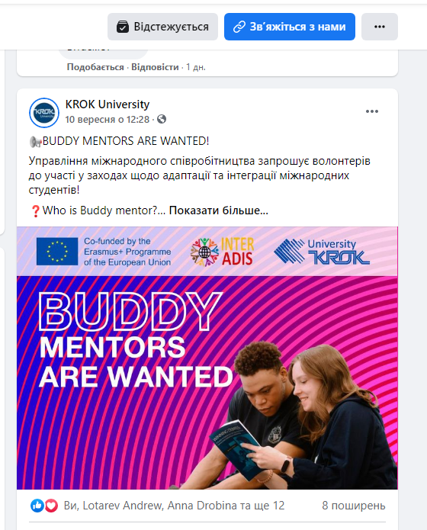
Buddy System
https://www.krok.edu.ua/ua/novini-ta-podiji/item/4376-buddy-mentors-are-wanted
Meeting with applicants is planned for end of October
13 applicants – Ukrainians and International Students
Guide for Buddies is under development
Design and production of Merch is planned

Slide 8
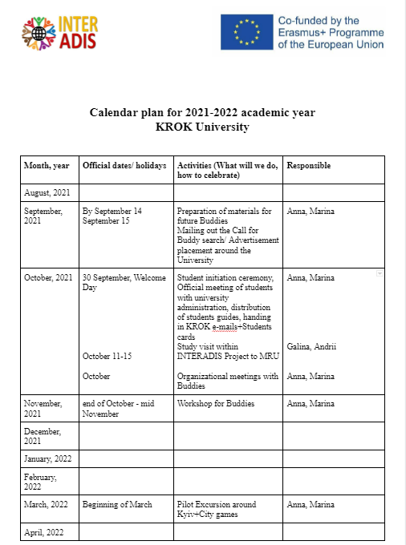
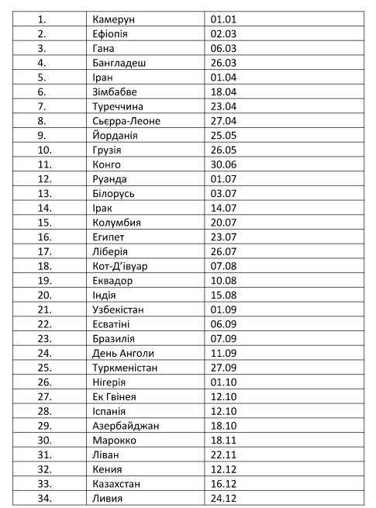
WP 2.3.Roadmap of IS integration developed
Calendar Plan
Official events, Organizational issues of training of IS
Cultural events –national holidays
Welcome day – meeting university administration, managers that will work with IS, tell about University, etc.
Involve lecturers for organization of excursions for IS
Structure: Upon arrival the meeting in group is organized, the schedule of meetings is Guides in different languages
Information about study programs at KROK – in different languages
Organization of city games,( group work, networking) (consider possibility for Online format in case of lockdown)
17 November Day of International Students
International Cultural Festival will be organized at KROK, May 2022 in the frameworks of INTERADIS
14 February, to prepare secret presents for better networking
Weeks of cuisine, 1 day of week. The student brings national meals and everybody tastes
List of important holidays per country (at least 1 important holiday for students of each country represented at KROK)

Slide 9
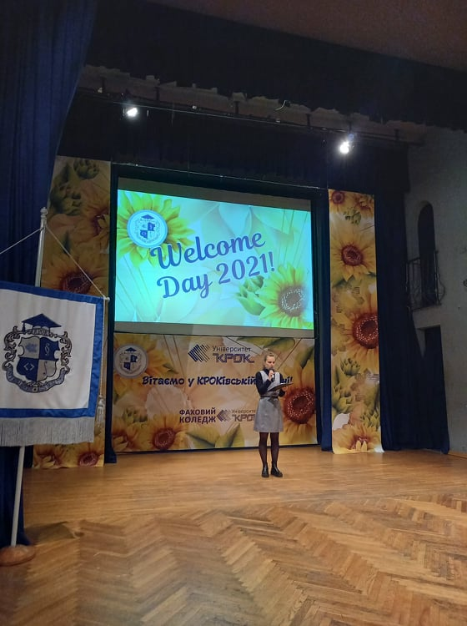
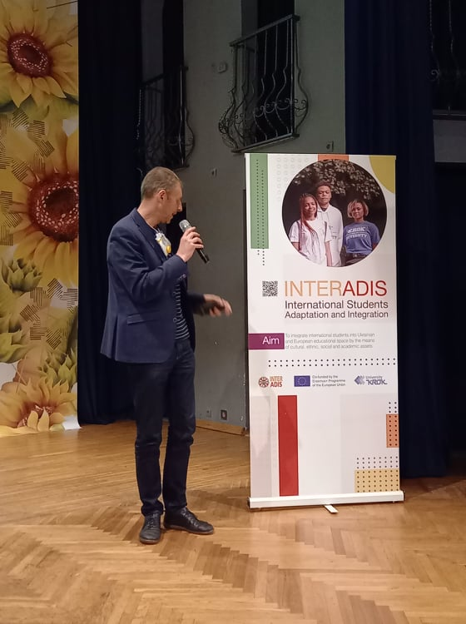
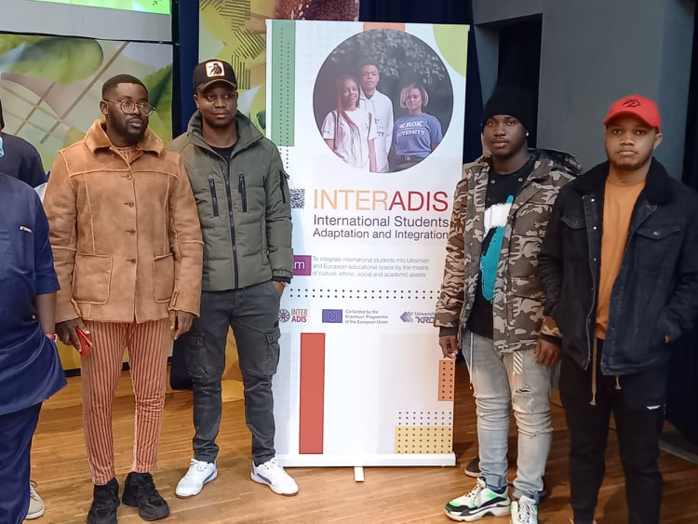
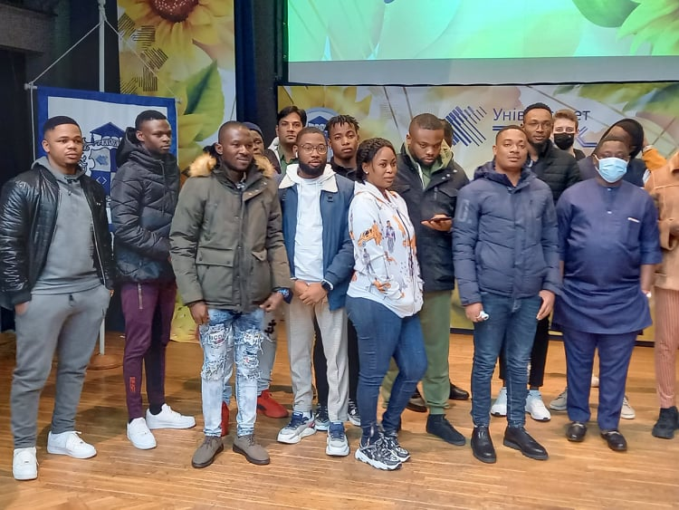
Welcome Day
Acquaintance with KROK;
Migration/Academic rules;
E-learning means;
Presentation of INTERADIS project

Slide 10
WP 2.4. Course for adaptation of the foreign students and other training materials
KROK will prepare the course “Passport and Visa Regime for IS”
0,5-1 ECTS
Video lecture for 15-20 min
Tests

Slide 11
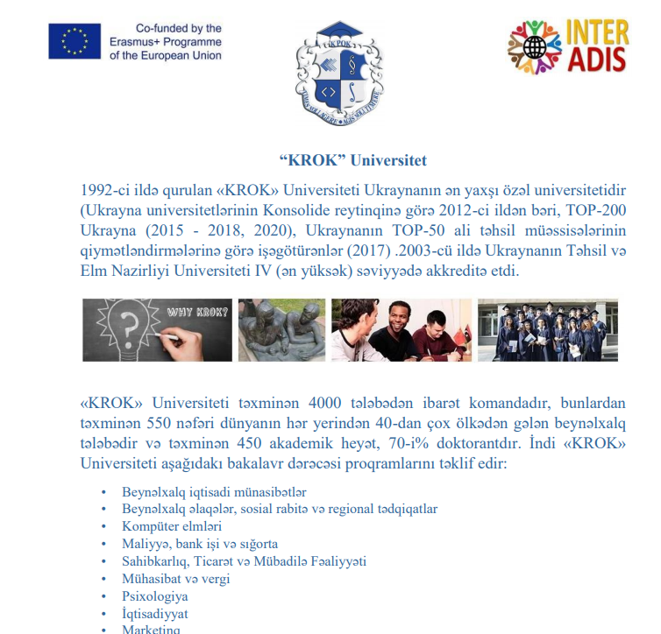
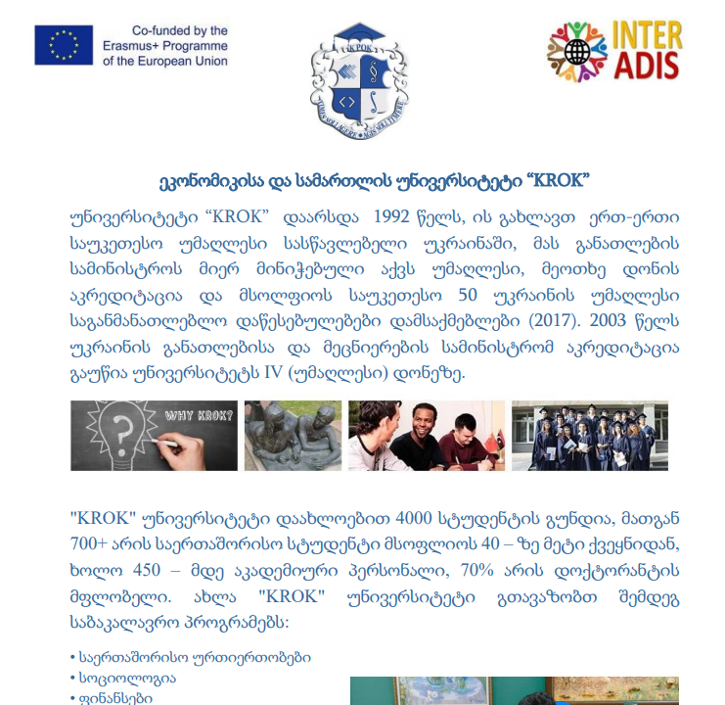
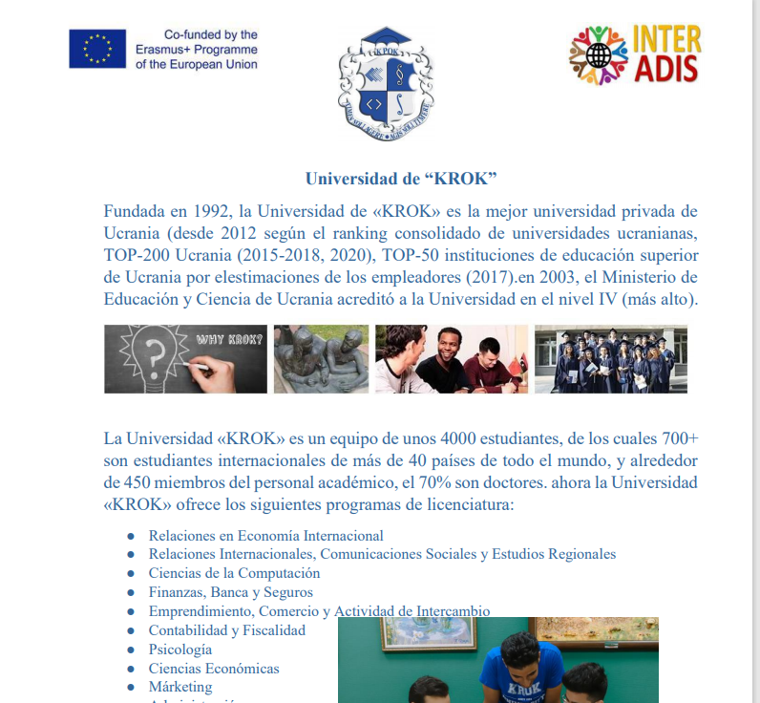
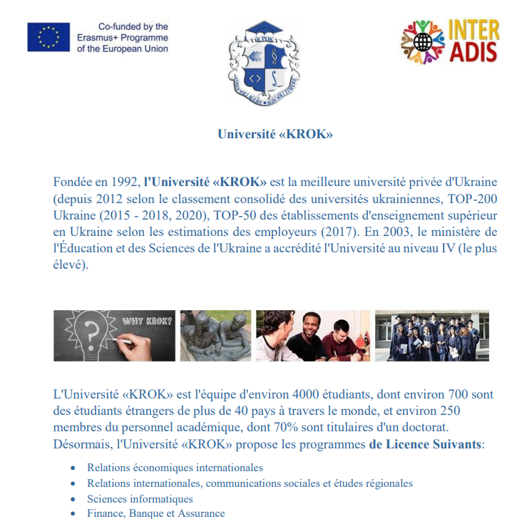
WP 2.4. Informational materials prepared and translated
Information for IS about KROK on different languages
Information about KROK University was translated in French, Spanish, Georgian, Azerbaijan and uploaded to KROK website
Students Guide prepared and translated into English

Slide 12
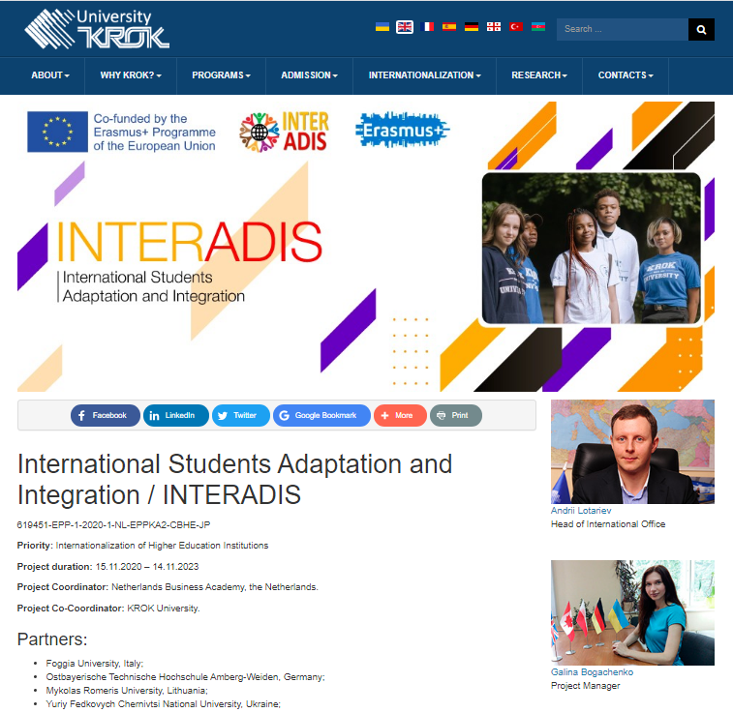
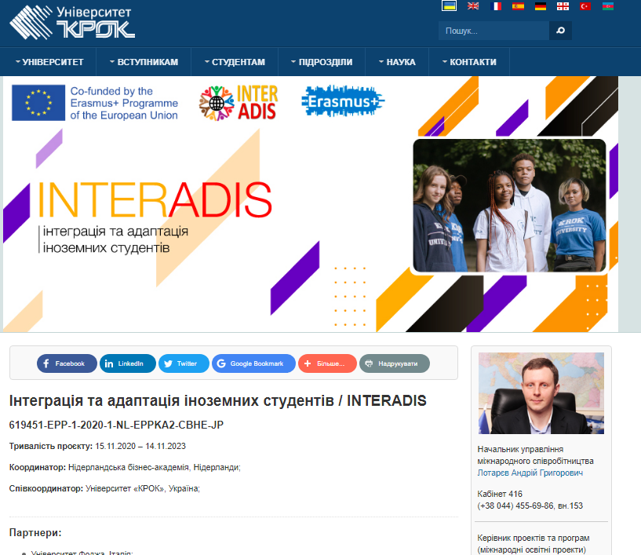
On the website of KROK

Slide 13
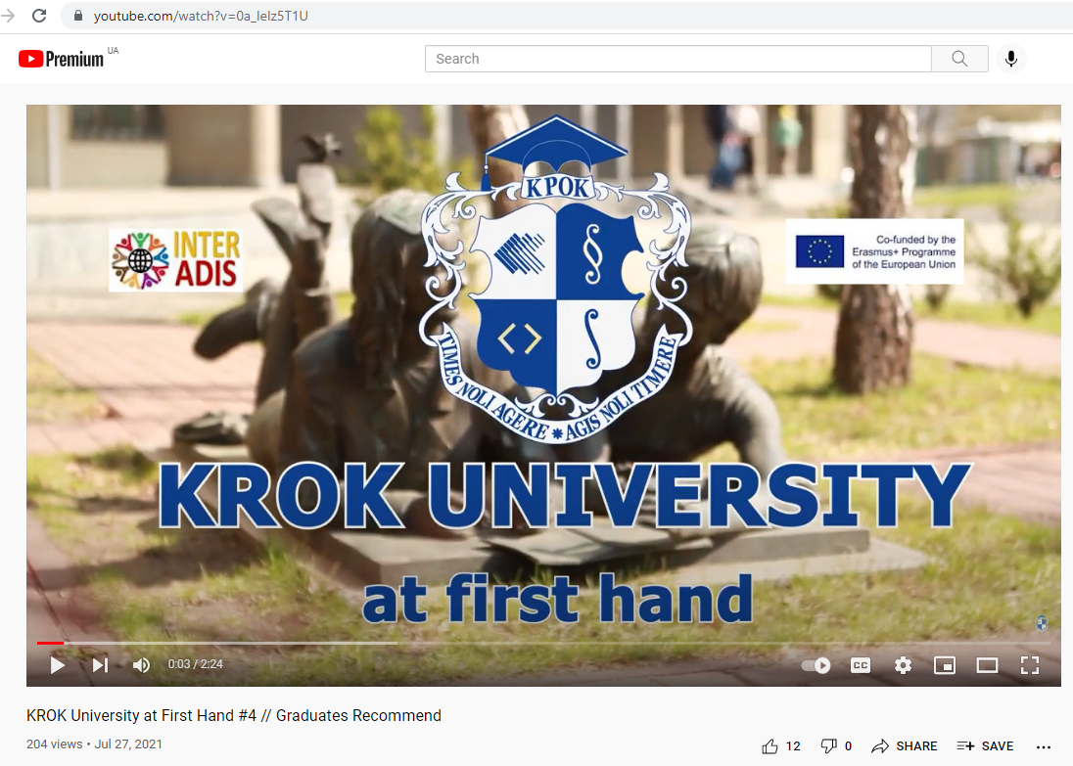


Promotion of KROK University thanks to INTERADIS
https://www.youtube.com/watch?v=0a_IeIz5T1U
There is the 4th episode of the «KROK University at First Hand» where our new-made graduates give recommendations to KROK applicants.
#INTERADIS is presented.
KROK video tour, with English subtitles

Slide 14
WP 2.6. University infrastructure modernization
The working group is created including International Office, Marketing Department, Security Department
The group considers different options to find the better solution
Pointers and maps around the University
Detailed menu in English in canteen
Key information in English on KROK for security department

Slide 15
Planned Activities for the nearest future
Info about KROK on 2 languages (Arabic and Farsi)
Video KROK tour done by International Students
Design and Production of Merch for buddies
Workshop for Buddies
Creation of E-Student’s Cabinet in English, Telegram-bot

Slide 16
Links with INTERADIS info
Name of the Activity | Link
Information about the Project on the website of your HEI, Eng | https://int.krok.edu.ua/en/internationalization/international-projects/interadis
Information about the Project on the website of your HEI, Ukr | https://www.krok.edu.ua/ua/proektna-diyalnist/mizhnarodni-proekti/interadis
News on SV 1 HUG | https://int.krok.edu.ua/en/current-news/item/267-online-part-of-study-visit-within-eu-erasmus-project-interadis https://www.krok.edu.ua/ua/novini-ta-podiji/item/4210-onlain-treninh-u-ramkakh-proiektu-erazmus
News on SV 2 MRU | https://int.krok.edu.ua/en/current-news/item/268-workshop-on-international-students-admission-and-integration-practices-within-eu-erasmus-project-interadis https://www.krok.edu.ua/ua/novini-ta-podiji/item/4215-krashchi-praktyky-po-pryiomu-ta-intehratsii-inozemnykh-studentiv
News on SV 3 OTH Amberg Weiden | https://int.krok.edu.ua/en/current-news/item/271-international-office-acquires-experience-of-germany-in-the-adaptation-of-foreign-students https://www.krok.edu.ua/ua/novini-ta-podiji/item/4220-ums-vyvchaie-dosvid-nimechchyny-z-adaptatsii-inozemnykh-studentiv
News on SV 4 NLBA | https://int.krok.edu.ua/en/current-news/item/272-online-study-visit-on-intercultural-communication-from-netherlands-business-academy https://www.krok.edu.ua/ua/novini-ta-podiji/item/4223-onlain-navchalnyi-vizyt-z-pytan-mizhkulturnoho-spilkuvannia-vid-niderlandskoi-biznes-akademii
News on SV 5 UNIFG | https://int.krok.edu.ua/en/current-news/item/276-international-office-acquires-italian-experience-in-international-students-integration https://www.krok.edu.ua/ua/novini-ta-podiji/item/4240-ums-vyvchaie-dosvid-italii-v-roboti-z-inozemnymy-studentamy
Kick-off Meeting | https://int.krok.edu.ua/en/current-news/item/258-kick-off-meeting-of-the-eu-project-erasmus-cbhe-interadis https://www.krok.edu.ua/ua/novini-ta-podiji/item/4138-ustanovcha-zustrich-proiektu-yes-erasmus-interadis

Slide 17
Links with INTERADIS info
Name of the Activity | Link
Bilateral meetings between partners | https://int.krok.edu.ua/en/current-news/item/293-visit-to-ukrainian-partner-within-erasmus-project-interadis
Presentation of INTERADIS at International Forum | https://int.krok.edu.ua/en/current-news/item/273-presentation-of-interadis-project-at-third-ukrainian-international-education-forum https://www.krok.edu.ua/ua/novini-ta-podiji/item/4229-prezentatsiia-proiektu-interadis-adaptatsiia-ta-intehratsiia-inozemnykh-studentiv
Presentation of INTERADIS at training for ESN networks | https://int.krok.edu.ua/en/current-news/item/261-online-training-by-erasmus-student-network-kyiv https://www.krok.edu.ua/ua/novini-ta-podiji/item/4141-erasmus-student-network-kyiv
Participation at Grantholders meeting | https://int.krok.edu.ua/en/current-news/item/257-grantholders-meeting-of-the-european-union-erasmus-program
Presentation of INTERADIS at all-Ukrainian scientific conference | https://int.krok.edu.ua/en/current-news/item/237-krok-university-in-all-ukrainian-scientific-methodical-conference https://www.krok.edu.ua/ua/novini-ta-podiji/item/4037-universytet-krok-vziav-uchast-u-vseukrainskii-naukovo-metodychnii-konferentsii-kafedry-ekolohii-kharkivskoho-natsionalnoho-avtomobilno-dorozhnoho-universytetu
Presentation of the project within Erasmus Days | https://int.krok.edu.ua/en/current-news/item/232-krok-university-joined-erasmusdays-world-marathon https://www.krok.edu.ua/ua/novini-ta-podiji/item/4034-universytet-krok-pryiednavsia-do-vsesvitnoho-marafonu-zi-sviatkuvannia-dniv-prohramy-erazmus
Presentation of INTERADIS at online training seminar “Fundraising. Writing projects. Successful cases” | https://int.krok.edu.ua/en/current-news/item/234-krok-university-among-leaders-of-ukrainian-heis-in-the-number-of-capacity-building-projects-won https://www.krok.edu.ua/ua/novini-ta-podiji/item/4018-universytet-krok-sered-lideriv-zvo-ukrainy-za-kilkistiu-vyhranykh-proiektiv-capacity-building
Information on winning of the grant | https://int.krok.edu.ua/en/current-news/item/222-erasmus-grant-winning-of-project-interadis-international-students-adaptation-and-integration https://www.krok.edu.ua/ua/novini-ta-podiji/item/3962-vitaiemo-z-peremohoiu-v-konkursi-yevropeiskoho-soiuzu-erazmus-z-rozvytku-potentsialu-vyshchoi-osvity
Buddy mentors wanted | https://www.krok.edu.ua/ua/novini-ta-podiji/item/4376-buddy-mentors-are-wanted

Slide 18
KROK activities as partner
KROK signed Partnership Agreement
KROK representatives participated at all 5 online SV
KROK staff and students filled the questionnaire
KROK filled the General Report on WP 1
KROK formed project working group, signed the university order
KROK developed pages of INTERADIS on the website
KROK posted all project news on the KROK website, Facebook page in Ukr and Eng
KROK representatives participated at management meeting
50% of KROK budget (excluding equipment costs) was transferred to University account

Slide 19
Thank you for your attention!

